Slide 1
User interface design

Slide 2
UI : November 25
Dr. Jillian Aurisano
Plan for today:
Announcements/Course logistics
Interaction styles
Direct manipulation
“Natural” / Expressive interactions
Thanksgiving assignment
Notes:
So welcome to engineering visual interfaces for data science. I'm Dr Aurisano.
Thanks for finding the class on Zoom. Hopefully we will be in person again soon.
If anyone out there is comfortable turning on their cameras, that is lovely- then I feel like I am talking to students, rather than to myself.
Here’s our plan for today:
First I’m going to introduce myself, so you know a bit about me
Then we are going to get to know each other, in Zoom breakout rooms. This will give us a chance to make sure that Zoom breakout rooms work, and we all know how to access them.
Then, I am going to walk through the structure, and plan for the course. I want to make sure everyone knows how the course will work, and what to expect, and also a bit about why the course is designed this way.
Then I am going to introduce the class, and what the class is about. Since this is a new class, and one of just a few classes in human centered computing here at UC, I wanted to give an overview of the topic.
Then I have an introductory activity, which we will do in breakout rooms, and which I think will help motivate the discussion on Wednesday, and getting into the meat of the class.

Slide 3
Interaction styles
We have mostly considered mouse and keyboard interactions with graphical user interface (GUI) elements
There is a wide world of other interaction styles and input modalities
Styles: GUI, Direct manipulation, “Expressive” or “natural” interaction
Modalities: Touch, Speech, Mid-air gestures, devices, tangible items

Slide 4
GUIs and Mouse and Keyboard
Interaction with visible graphical elements (buttons, drop down menus, sliders….)
Input through a mouse and keyboard devices
(or also through clicking+scrolling inputs from a trackpad)

Slide 5
Direct manipulation
Consider a car navigation
Direct manipulation
You can see the scene you are navigating through via the window
When you want to turn left, you turn the steering wheel to the left
Your position in the world changes immediately (feedback), and through the window you see the response to your left turn action
Indirect manipulation
You input a degree of turning angle into a form box
You input a direction left or right using a checkbox
You hit a button labeled ‘turn’
Which would you rather do?

Slide 6
Direct manipulation
Features of direct manipulation
Continuous representation of the object of interest
Physical actions instead of syntax
Continuous feedback and reversible, incremental actions
Rapid learning

Slide 7
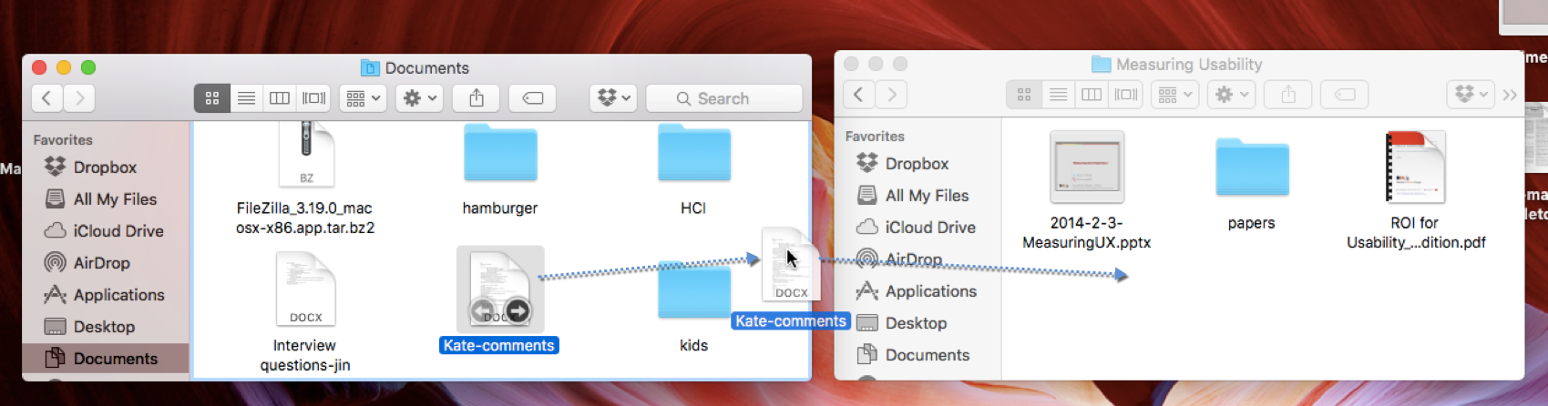
Drag and drop UI’s- direct manipulation?
Is this direct manipulation? Let’s look at the rules
Continuous representation of the object of interest
Physical actions instead of syntax
Continuous feedback and reversible, incremental actions
Rapid learning

Slide 8
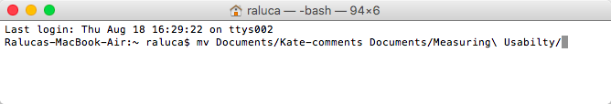
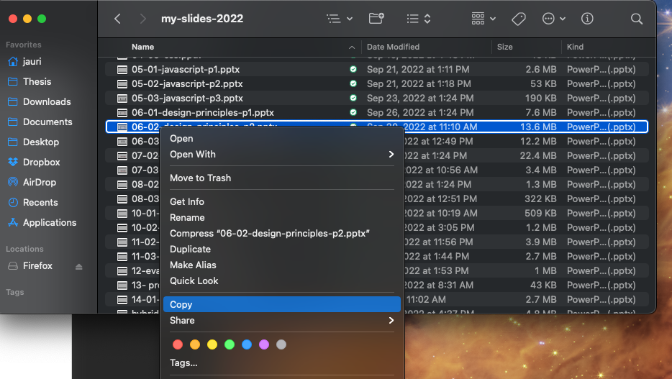
Direct manipulation?
Is this direct manipulation? Let’s look at the rules
Continuous representation of the object of interest
Physical actions instead of syntax
Continuous feedback and reversible, incremental actions
Rapid learning

Slide 9
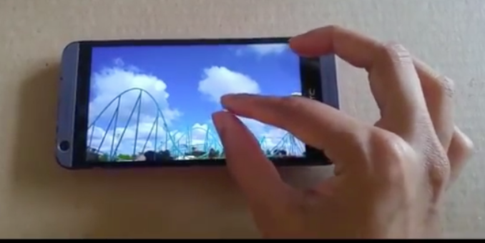
Direct manipulation in UI design
Pinch touch gesture, image zooms in

Slide 10
What are the benefits of direct manipulation
Consider drag and drop vs command line (mv file1.txt folder/.) file manipulation
What are some reasons drag and drop may be more usable?

Slide 11
Direct manipulation benefits
Features of direct manipulation
Continuous representation of the object of interest
Gives you immediate visual feedback
Physical actions instead of syntax
Recognition vs recall- don’t have to remember a command
Continuous feedback and reversible, incremental actions
Error recovery

Slide 12
Disadvantages of direct manipulation
Can we think of any?

Slide 13
Disadvantages of direct manipulation
Limited number of objects that can be interacted with, because must be visible
Have to navigate to the objects to see them, which can be time consuming
Physical motions are tiring and time-consuming
Accidental activation is common in some systems (Eg touch)
If items are not draggable, or can’t be dropped somewhere- may just get no feedback
Discovering that something can be moved may be difficult, vs a menu system or set of GUI options
Better for novices than experts
Repetitive tasks are not well supported
Some gestures are error prone- dragging a small item into a small spot
Not great for folks with motor skill impairments or visual impairments

Slide 14
Tangible user interface
3d printing + AR
Manipulation of a physical object, directly manipulates a 3d model
https://www.youtube.com/watch?v=gZxK6j4JTHQ
(and just for fun…. https://www.youtube.com/watch?v=br-YxeXWx6s)

Slide 15
Direct manipulation with a touch table to compose UI’s for music
https://www.youtube.com/watch?v=AKozzspLojI&t=42s

Slide 16
Direct manipulation in 2.5D
https://www.youtube.com/watch?v=Eb8Qu-Z0ERw

Slide 17
Bump top
https://www.youtube.com/watch?v=6jhoWsHwU7w

Slide 18
Direct manipulation considerations
Effectiveness is related to:
Strength of the metaphor chosen to represent actions and objects
Use familiar metaphors
Use appropriate metaphors for the action and the items
Example- metaphor of moving objects on a desk, translated into an interaction- familiar and appropriate
Translation distance- how many steps of translation between the user’s action and the outcome
Are they interacting with a intermediate device (mouse, trackpad, joystick, game controller. There is a translation step from the actions and the responses on screen
Compare game controller to trackpad to direct touch manipulation
2D vs 3D
Direct touch to 2D objects vs Direct touch to manipulate 3D objects that are beyond the 2d screen

Slide 19
Expressive or natural interactions
Vision: people would not need to learn an interface. They could interact with computer systems through inputs such as speech, pointing gestures…
The appeal is obvious…. What if everyone had an intelligent assistant on their computers
No need to learn a UI
Can just ask for what you need
Ultimate goal- intelligent assistants

Slide 20
Intelligent computer based assistants- features
Voice input
Speaking rather than typing or clicking
Natural language understanding
Users not restricted to using a specific syntax or command structure, can just talk
Like human conversation
Voice output
Assistant talks back to you
Intelligent interpretation
Assistant utilizes context, past behaviors…
Agency
Assistant may do actions the user hasn’t requested

Slide 21
Interaction with an ‘intelligent’ assistant
What are the limitations?

Slide 22
Challenges with spoken interactions
Initiation
How to indicate that they wish to start the spoken interaction?
“siri” “Ok Google”
How well does this work for you?
ever have the system fail to initiate when you intend it to?
Or initiate when it shouldn’t?

Slide 23
Challenges with spoken interactions
Knowing what to say
What can I ask?
Learnability is a huge issue- current systems can’t do everything- and there is no visual presentation of the options
How well does this work for you?
Mapping inputs to actions
Do I know how the system will respond?
Simple systems with a limited command grammar work better

Slide 24
Challenges with spoken interactions
Recognition errors
Still problems in speech to text translation
Problems for accents
Problems for high voices
Correcting errors / Undo
Other than stop or cancel, how to cleanly undo?
Feedback and dialogue
Shall I go ahead? Did I get this right?

Slide 25
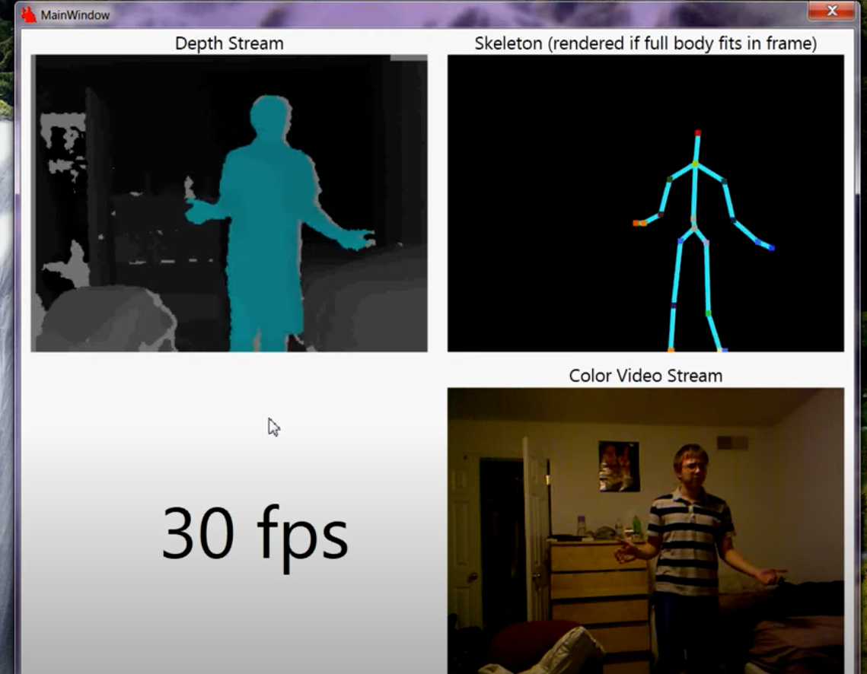
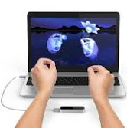
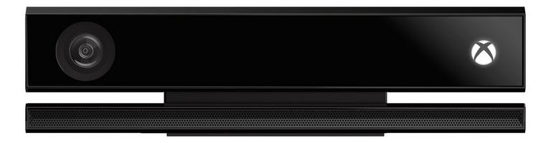
Mid-air gestures
Enabled by skeleton tracking or image recognition technologies
Significant work still needed to interpret movements and body positions into interactions

Slide 26
Example of a new approach to use midair gestures

Slide 27
Touch gestures
Trackpads and touch displays can respond to inputs other than point and click
Example- mac track pad
The story isn’t over- how should we design interfaces that are compatible with a wider range of gesture inputs ?

Slide 28
Bringing gestures and natural language (and AR) together
Concept from Microsoft
https://www.youtube.com/watch?v=Mr71jrkzWq8

Slide 29
Interaction through devices
HUGE range of interaction devices
Mouse, keyboard
Remotes
Video game controllers
Trackpads, which can recognize touch gestures
Direct touch displays
Phones and tablets, which can connect and control other devices
Stylus- sketch interactions

Slide 30
What do people need to be able to do?
Indicate
Select
Swipe/Scroll
Position
Orient
Quantify
Enter text
Create a path
Different kinds of devices and interactions will be better/worse at performing these kinds of tasks

Slide 31
Hot topic
How to design Uis for interaction styles and devices
How to create interactive inputs through modes other than Mouse/Keyboard/GUIs
How to explore?
Narrative sketches
Hybrid sketches

Slide 32
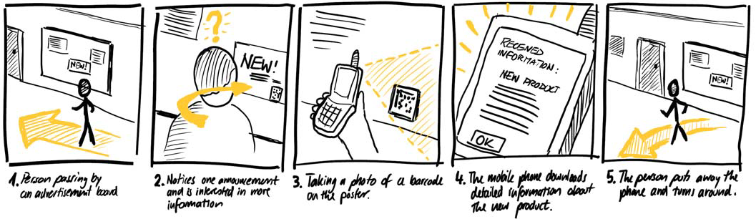
Narrative sketching
Capture the user, the device, the context, the UI, the world, in a sequence of sketches

Slide 33
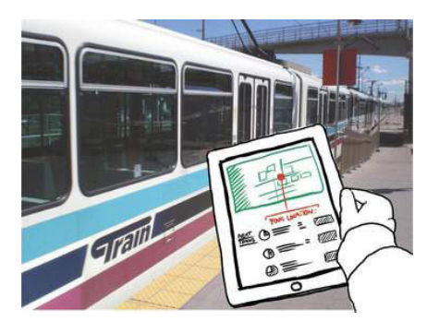
Hybrid sketches
1. Take a photo, from the point of view of the user
2. Sketch- using paper, a digital tool
3. Integrate the two

Slide 34
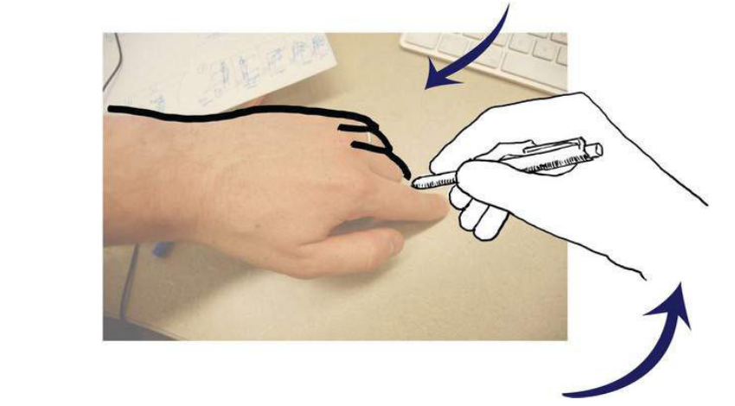
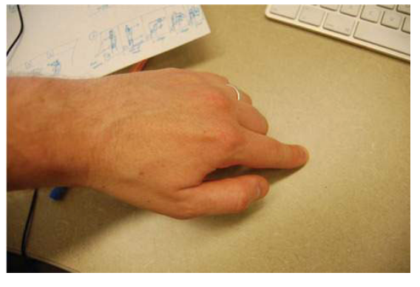
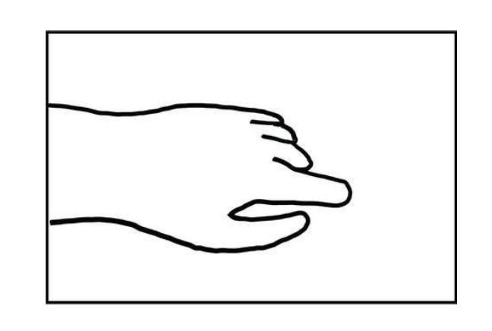
Photo traces
You can create sketches with realism using a photo tracing technique

Slide 35
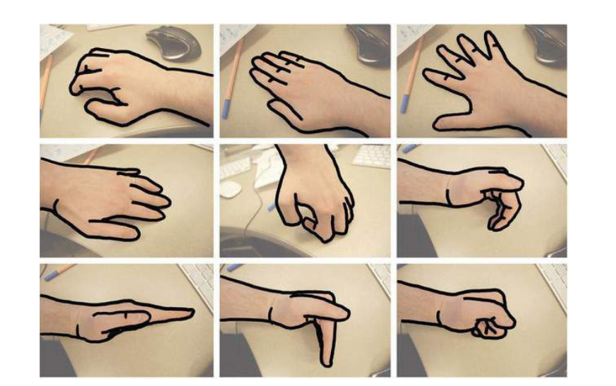
Photo traces example

Slide 36
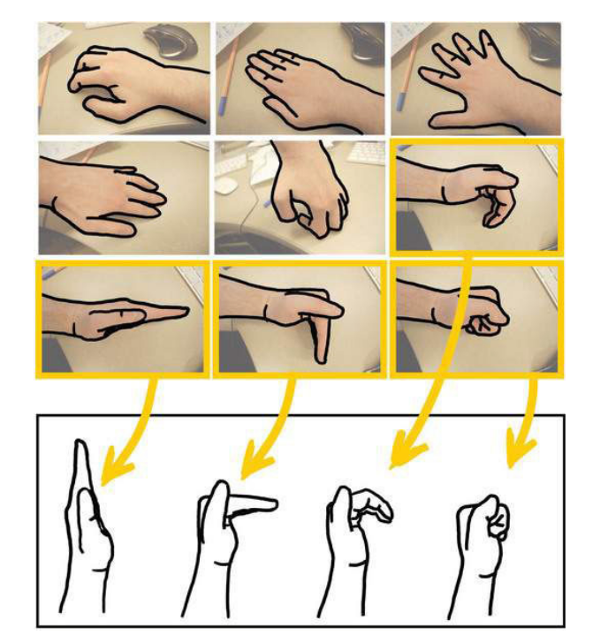
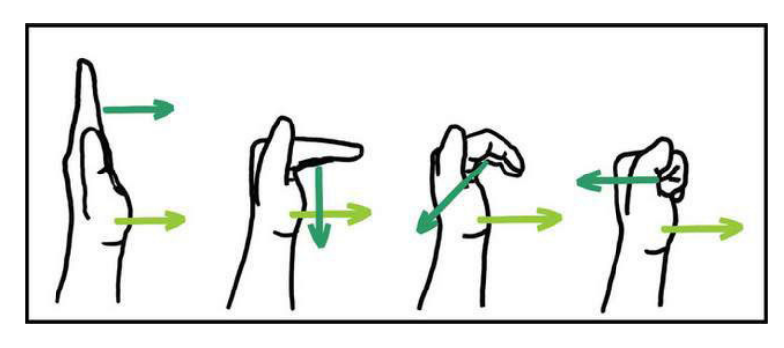
Photo traces of gestures

Slide 37
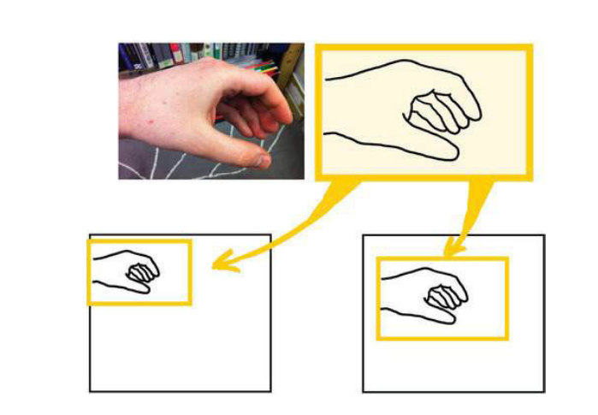
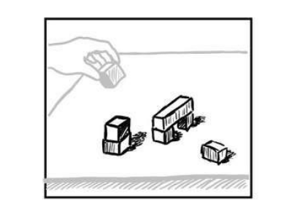
Photo traces to interact with objects

Slide 38
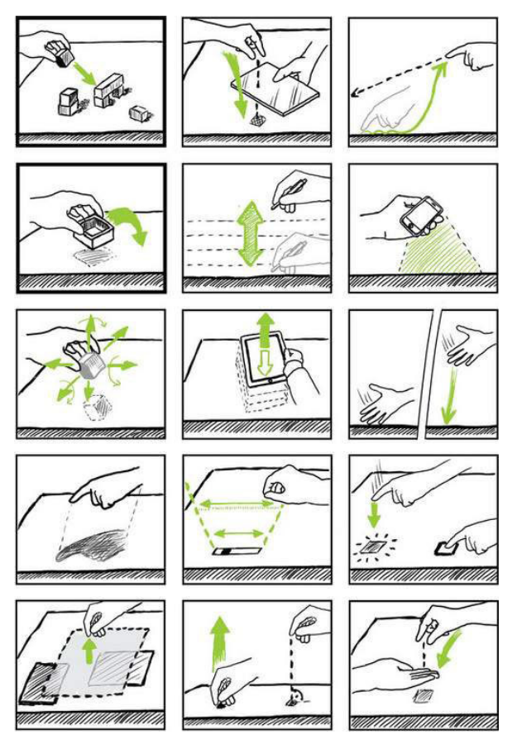
Photo traces interactions

Slide 39
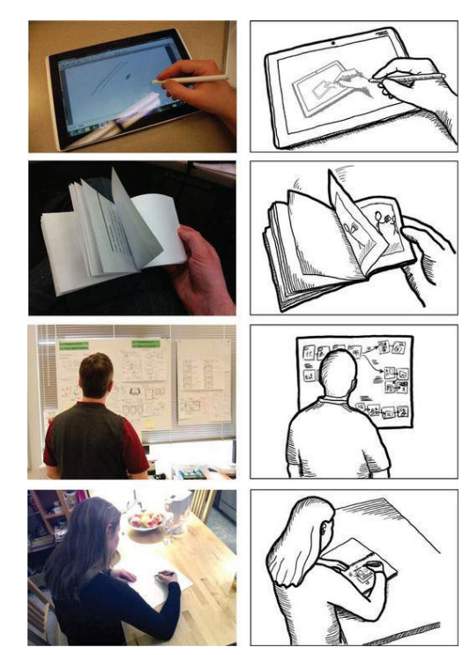
Photo traces including people and devices

Slide 40
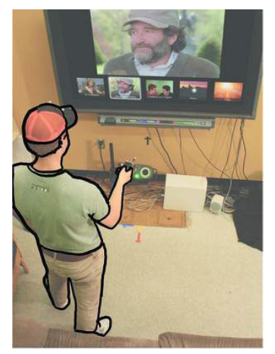
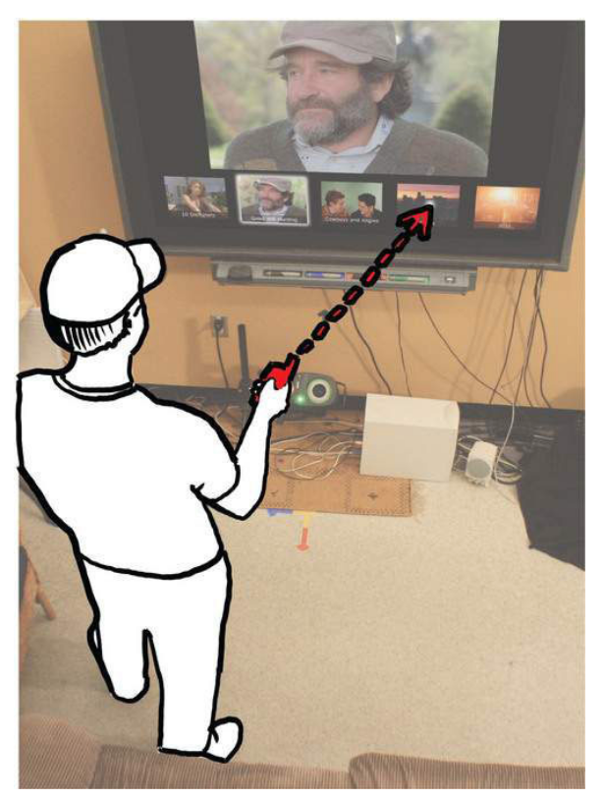
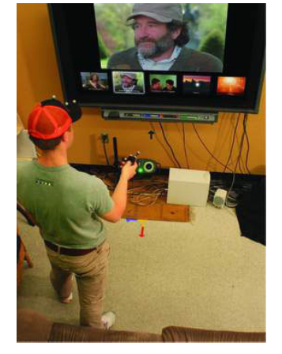
Hybrid sketching with photo traces

Slide 41
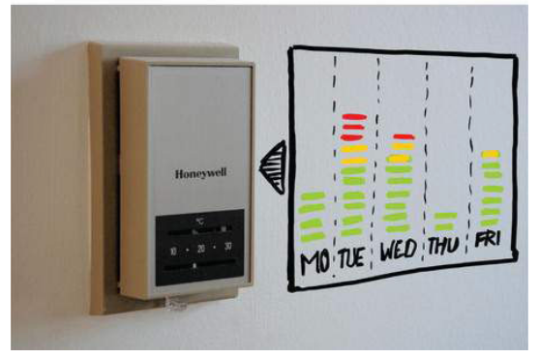
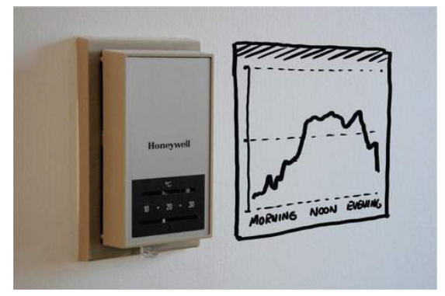
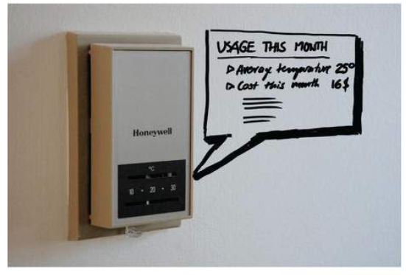
Augmented reality thermostat

